Slide 2
Contents
PART 1 Product advantages
PART 2 Application scenarios
PART 3 Product parameters
PART 4 Product pictures

Slide 3
PART 1. Super Hit Mini Product advantages

Slide 4
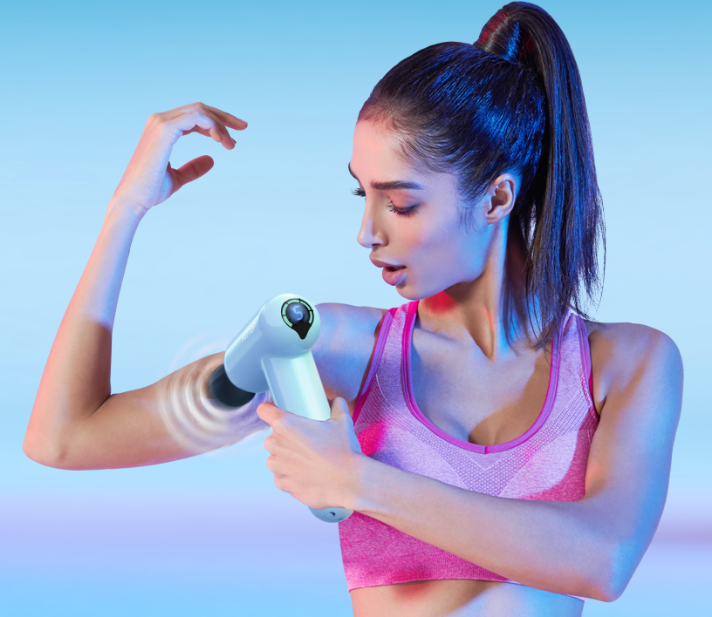
12MM Deep Percussion Professional massage gun
The Smallest Massage Gun at a professional level
◎ Intelligent touch control design
Speeds adjustable at your fingertips. One button control, light and Intelligent.
◎ Touch screen design with battery and speed display
◎ USB cable design Easy to be charged with power bank (rechargeable battery).
◎ Tin Phosphor Bronze Motion Sleeve Core material makes percussion more smoothly and super quiet.
◎ Top Grade Bearings Quiet operation, wear and corrosion resistance, core material for more than 10 years using.
◎ Nanocrystalline Piano Paint Coating Exquisite seven layers of quenching, excellent texture and brilliant design.
◎ 18650 Tesla Same Model Battery
Long battery life, fullly charged once for more than 15 days using. No worries for long trips.

Slide 5
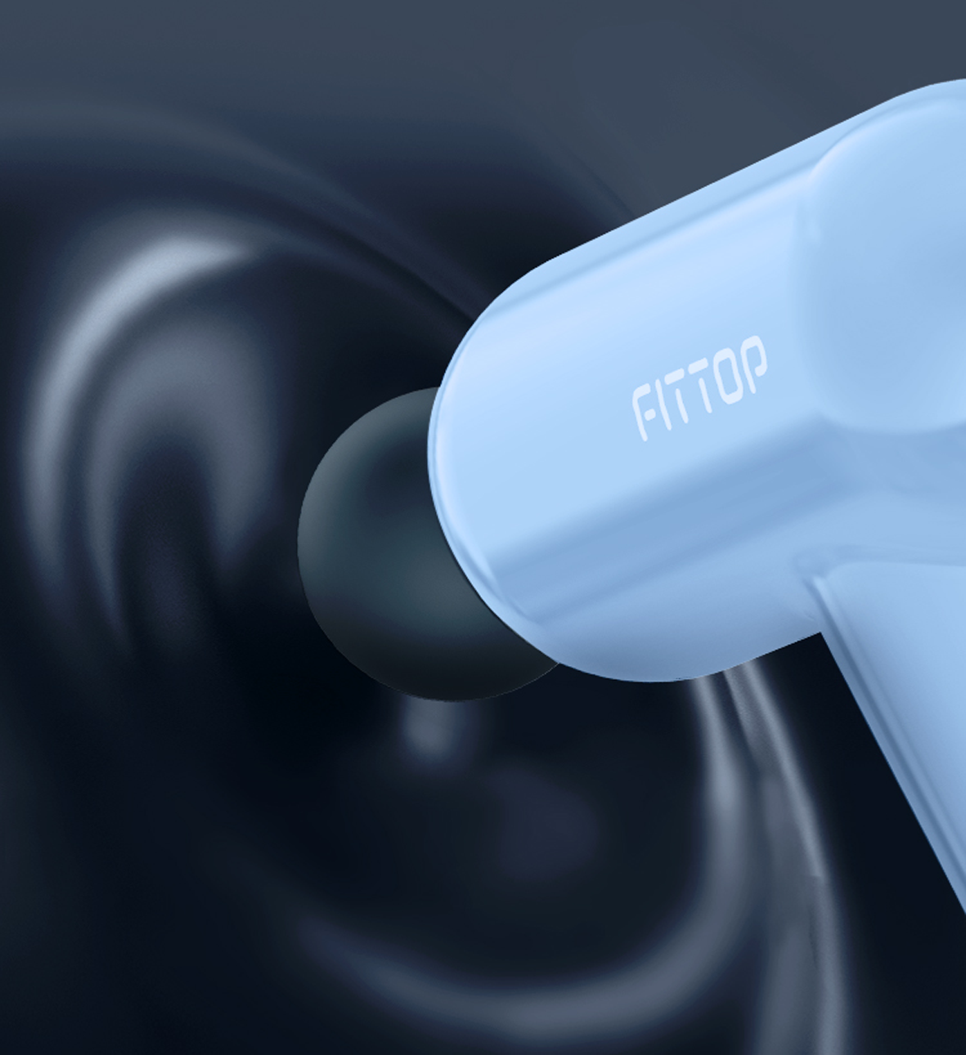
Unique product advantages
◎ 12mm deep percussion. A massage gun with less than 12mm amplitude, hardly hit deep muscle fascia and achieve the relaxation effect. Super-Hit Mini adopts the performance core of the professional-grade fascia gun and can easily reach the amplitude of 12mm.
◎ Euqipped with USB charging cable, Super hit Mini can be charged anytime and anywhere with power bank. No worries about running out of electricity on business trips, Super hit mini always keeps you full of energy.
◎ Intelligent touch control design with battery and speed display.
When Super hit Mini turned on, 5 speeds can be easily adjustable by touching the screen.

Slide 6
Attractive buying proposition
◎ Warm-up and activate muscles before exercises, to improve muscles
performance and prevent muscles from injury.
◎ Fascia relaxation after exercises, to remove latic acid and prevent delayed
onset muscles soreness(DOMS).
◎ Suitable for sedentary office groups and those long standing
professionals, to relieve shoulder and neck sorness, lumbar muscle
strain and lumbago, to prevent occupational diseases.
◎ Resolve fascial nodules and relieve pains caused by nodular fasciitis.
◎ Comfortable massage, powerful and deep percussion（5 adjustable
speeds, highest up to 3500rpm, 12mm deep amplitude).
◎ Easy operation (touch screen, speeds and battery level all at one glance).
◎ Lightweight, tireless after long time use, small size and portable.

Slide 7
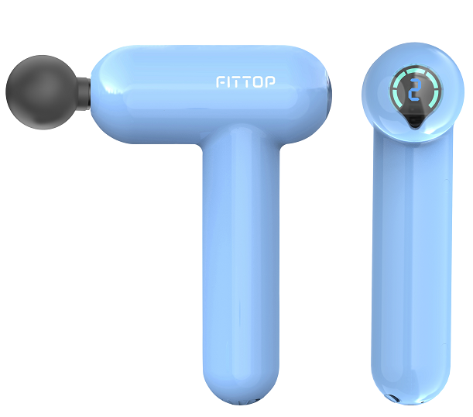
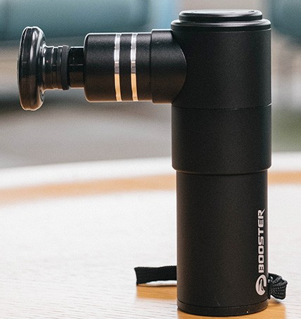
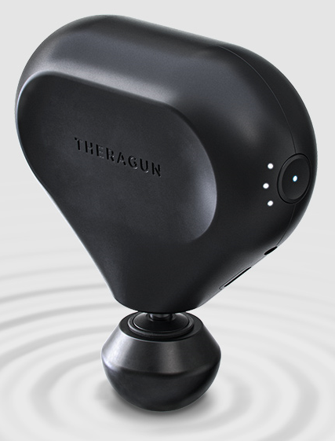
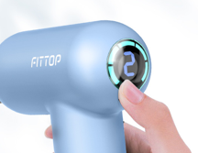
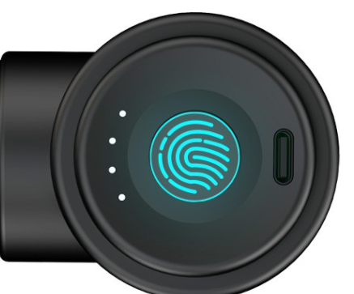
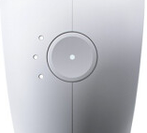
Massage guns comparison
Company | Fittop | Booster | Theragun | Analysis
Pictures
Model | Super Hit Mini | Mini pocket massage gun | Mini massage gun
Appearcance | Exquisite piano finish coating, 7 processes. | Matte surface | Matte surface | Fittop, the most fashionable and eye-catching color matching, the surface treatment process with piano coating, 7 processes, exquisite high-end, scratch-resistant.
Button control | Touch screen | Button Control | Button Control | 1. Button operation is more traditional. 2. Fittop's original smart touch screen design, full of sense of technology, cool, simple and easy to operate

Slide 8
Massage guns comparison
Company | Fittop | Booster | Theragun | Analysis
Pictures
Amplitude | 12mm | 8mm | 12mm | The Booster's percussion into fascia is 8mm and cannot reach the deep fascia. It is only suitable for surface muscle relaxation; some competing products exaggerate the amplitude, which is actually 9-10mm, not 12mm But Fittop has an amplitude of 12mm, which can reach deep fascia.
Frequency/Min | 1st level: 1575±10% rpm 2nd level: 1975±10% rpm 3rd level: 2300±10% rpm 4th level: 2600±10% rpm 5th level: 3500±10% rpm speed acceleration mode | 1st 900rpm 2nd 1800rpm 3rd 2500rpm 4th 3200rpm | 1st 1750rpm 2nd 2100rpm 3rd 2400rpm | The maximum speed of Booster & Theragun are lower than 3500 rpm; but if the maximum speed is very small, the first impression of the consumer is not deep enough, and consumers will feel that the massage is not strong. But Fittop has a maximum speed of 3500 rpm, the strongest and most professional massage force, which can reach deeper fascia and help muscles relax.
Speed Level | 5 levels | 4 levels | 3 levels | 3-4 speeds are normal, Fittop has 5 speeds. There are more speeds selections, and it has a stepless speed regulation function, which can adjust the speed you like at will. The speeds of competing products are fixed and there is no stepless speed regulation.

Slide 9
Massage guns comparison
Company | Fittop | Booster | Theragun | Analysis
Pictures
Battery | 2400mAH lithium battery, 18650 battery | 2900mAh lithium battery | 2000mAh | Fittop batteries have a higher capacity, longer battery life, and are easier to travel with and carry around.
Durance | High speed: around 4.5-6.5h; Low speed: around 11h(depends on use frequency); last for 15 days full charge; | 16h if keep using at lowest speed. | 150mins | The battery life of most suppliers is generally calculated according to the lowest speed, and the battery life and battery capacity are also related to the specific usage; Fittop's expression is more realistic, and the working hour is medium to upper level.
Charging | USB | USB | USB | USB portable special charging cable design Convenient to charge with power bank（Easy to charge and carry）

Slide 10
Massage guns comparison
Company | Fittop | Booster | Theragun | Analysis
Pictures
Conclusion | Fittop Super Hit Mini 1. Intelligent massage black technology, 12MM Deep percussion amplitude, (the smallest massage gun at a professional level), and a good massage experience; 2. The smart touch screen is with attractive selling points and is quite competitive; 3. The appearance and color is fashionable, and the appearance is attractive, popular to the modern people; 4. High cost performance. | Small Size, but power is not strong enough. There are many similar design in the market. | Famous Brand, but it's not competitive expensive for customers. | In general, most of the mini massage guns on the market have the similiar appearance, and there is no unique selling point to buy; the percussion intensity is not strong enough; However, the Fittop Super Hit Mini massage gun has been upgraded and improved in terms of functions, appearance and noise: original intelligent control touch buttons, integrated design of power and speed display and touch controls , powerful and deep percussion, silent and long battery life, comfortable grip, high-quality texture.

Slide 11
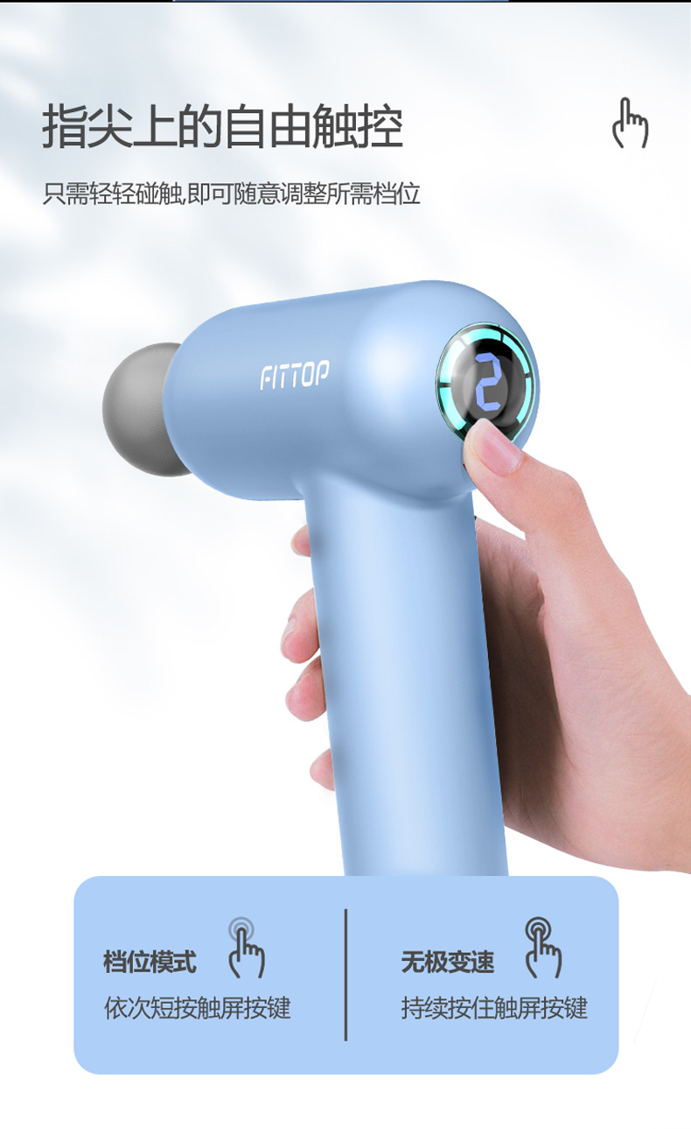
Super Hit Mini
Massage Gun- Advantage 1
Smart touch screen design
Unique water droplet smart touch screen design, integrating battery power, with speed levels. Standby status after power on. Lightly touch to gently switch modes between 1st and 5th speed.

Slide 12
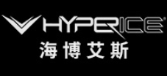
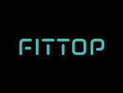
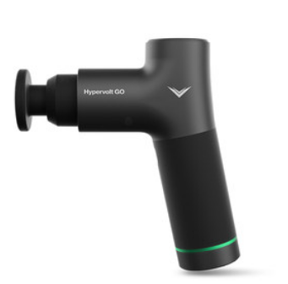
Comparsion
Traditional button design
Unique water droplet smart touch screen design,
lightly touch to gently switch modes

Slide 13
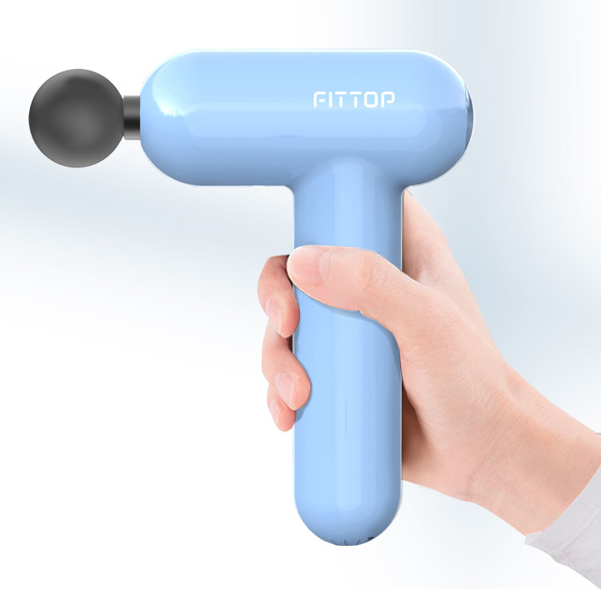
Super Hit Mini
Massage Gun- Advantage 2
Small size and portable
Strong powerful, but only 0.6kg, comfortable holding even in long time use. Easy to be carried along with you out for fitness and exercise.

Slide 14
Super Hit Mini
Massage Gun- Advantage 3
Super Hit Mini筋膜枪- 优势 3
12mm Deep Percussion
Configured with high-torque brushless motor, starting power up to 853mN.m. It has 12MM percussion amplitude, strong power deep into fascia, provides pleasant relaxation massage.
* Traditional Mini massage gun is generally 7.5 mm.

Slide 15
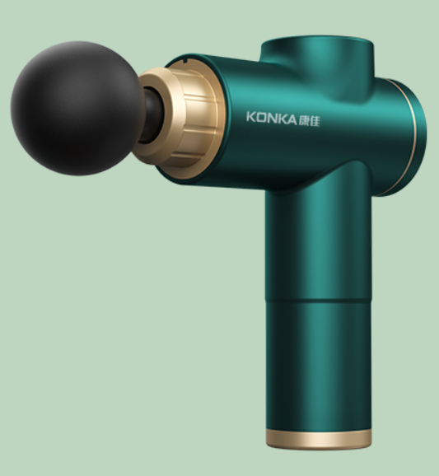
Comparsion
8mm percussion amplitude.
12mm percussion amplitude, deep myofascial relaxation after fitness exercise.

Slide 16
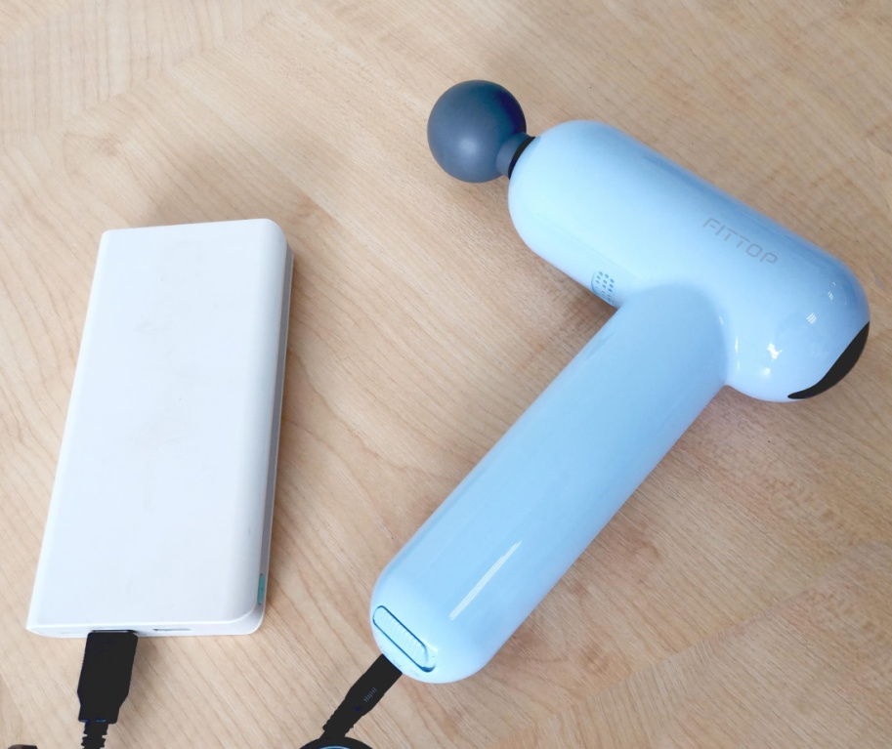
Super Hit Mini
Massage Gun- Advantage 4
USB portable charging cable
Configured with USB portable special charging cable, can be charged anytime and anywhere.
Rechargeable battery, no worries about running out of power when you’re outside for fitness, travel, business trips.

Slide 17
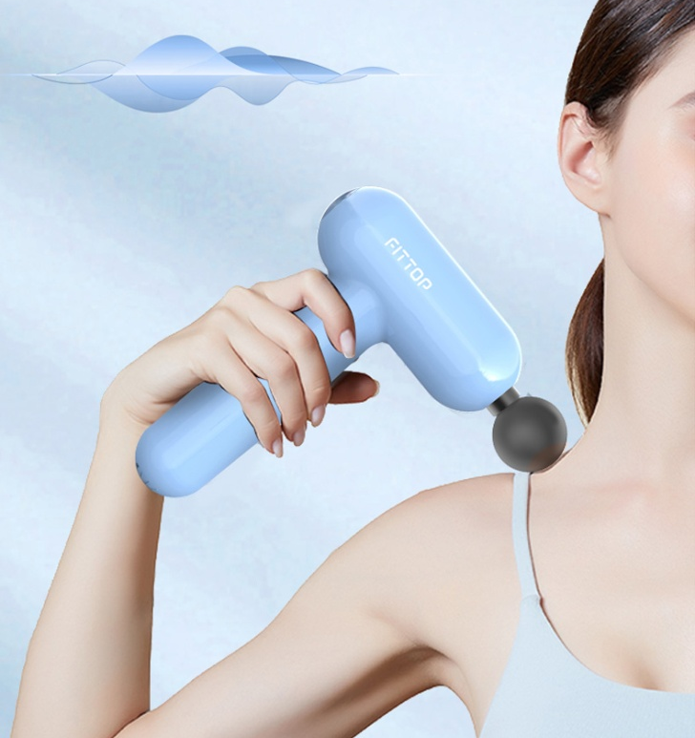
Super Hit Mini
Massage Gun- Advantage 5
Quiet Percussion Low Noise
High-quality brushless motor, quiet, low noise. No matter in the gym, home or even office, others will not be disturbed, you can enjoy a quiet and comfortable moment of relaxation.

Slide 18
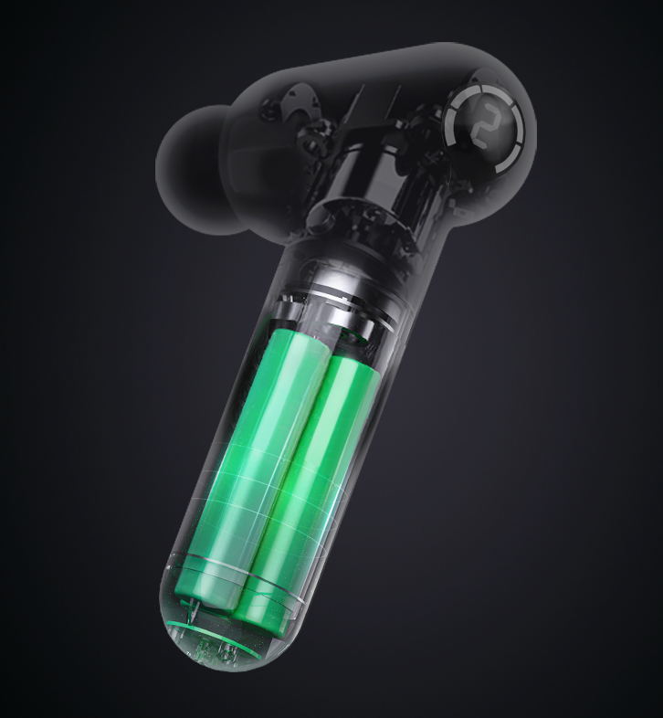
Super Hit Mini
Massage Gun- Advantage 6
Sports car-grade batteries for long battery life
Super Hit Mini Using sports car-grade lithium battery, longer battery life, and no worry about frequent charging. After a full charge, massage for one hour a day, and it can last for 15 days. It is a must for business trips. Relaxing massage anytime, anywhere.

Slide 19
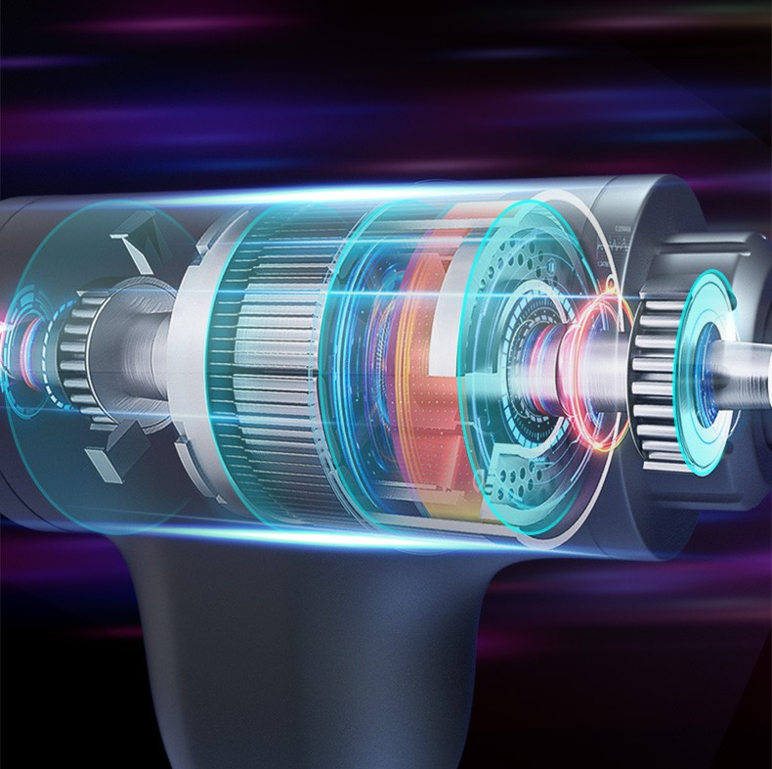
Super Hit Mini
Massage Gun- Advantage 7
High Torque Brushless Motor
Use 8.4V high-power brushless motor to bring strong surging power,3200 rpm high speed shock, Quickly destroy the lactic acid produced after exercise, giving you a comfortable experience of hitting the depths of the body.

Slide 20
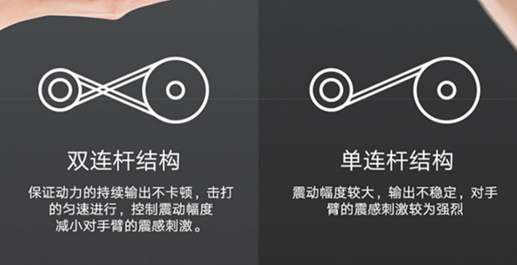
Super Hit Mini
Massage Gun- Advantage 8
Double bearing structure design
The double bearing structure ensures that the continuous output of power is not stuck, and the percussion sensation is performed at a uniform speed, avoiding the adverse stimulation of the muscle massage by the unstable output, and giving you a better massage and relaxation experience

Slide 21
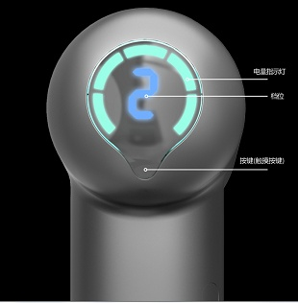
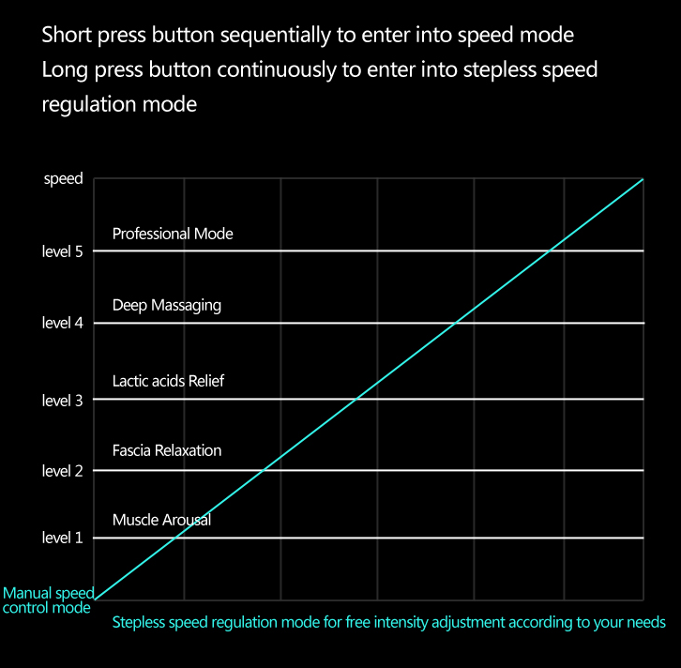
Super Hit Mini
Massage Gun- Advantage 8
5 speed control +
stepless speed control
5 speed control,
2 transmission modes,
Speeds up in touch stage,
Long press infinitely variable speed,
5 speeds can reach 1050~3200 RPM, corresponding to various muscle fascia relaxation requirements.
Speed 1 1575rpm±200 RPM awakens muscles
Speed 2 1950rpm±200 RPM fascia relaxation
Speed 3 2300rpm±200 RPM decomposition lactic acid
Speed 4 2600RPM ±200 RPM/min depth mode
Speed 5 2600-3200RPM ± 200rpm professional mode

Slide 22
Super Hit Mini
Massage Gun- Advantage 9
3 kinds of massage heads
Different from traditional massage head, super-hit Mini's three massage heads are made of 100% new ABS material, with no odor, more skin-friendly and deeper energy delivery.

Slide 23
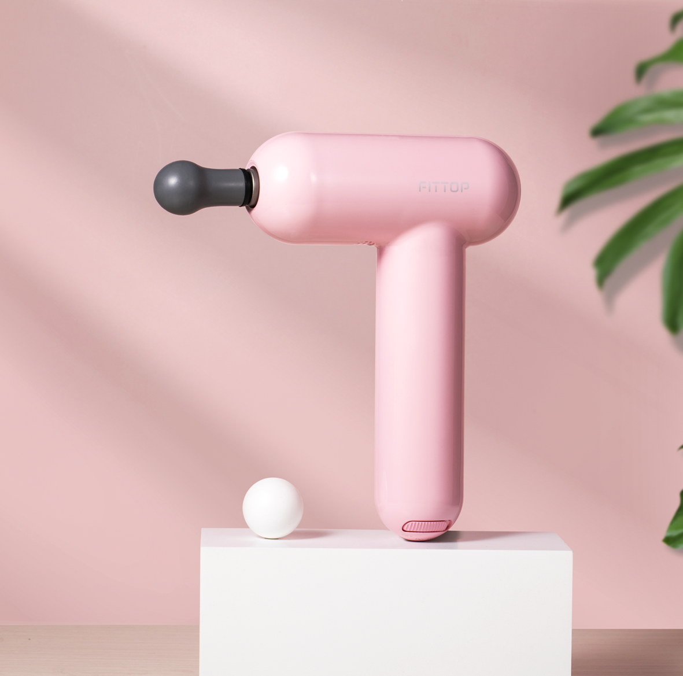
Product Advantage
◎ 12MM amplitude, deeper and stronger percussion, the smallest professional-grade fascia guns.
◎ Intelligent touch design, clear display of power and modes, easy to operate.
◎ Small and portable, light body, easy to carry when going out to exercising or traveling.
◎ Quiet percussion and low noise, enjoy a quiet and comfortable moment of relaxation.
◎ Five-speed modes+ stepless speed control, you can choose your speed level to meet the muscle and fascia relaxation needs.
◎ USB portable special charging cable design, no need to worry about the product running out of power, bring the power bank and charge it when you're outside.
◎ Built-in high-speed brushless motor, strong power and longer life, provides a comfortable experience and deeply to the muscle.
◎ 100% new ABS material, with no odor, more skin-friendly and deeper energy delivery.
◎ Built-in 18650 battery from major manufacturers, can be used for 15 days when fully charged, no worries for long-distance travel.

Slide 24
User experience feedback
This muscle relaxer massage gun will always be my favorite.
I've fallen in love with skipping rope lately! Because I saw that many bloggers on said that skipping rope can help you lose weight. But I skipped rope for almost a week, and found that my leg muscles are stronger, I massage every time after exercise, it seems to be useless! So I asked a friend who likes fitness, and she recommended a Fittop massage gun to me~
This product is very compact and convenient that can be put into a pocket, suitable for outdoor + office + home use! Use it anytime to relax your muscles! And the operation is very simple, even if the elderly want to relax their muscles, they can easily operate it!
Although the mini version is small in size, it is no less than the professional version of the massage gun with a percussion amplitude of 12MM, and the body weight is only 0.6kg, which is less than half of the ordinary professional massage gun!It is also equipped with a USB portable charging cable, so you are not afraid of running out of power when you go out to exercise! With just a light touch, you can adjust the speed level 1 to level 5 at will. After exercising every day, I use it to relax my muscles. My muscles are really relaxed a lot,my calf muscles are no longer thick.

Slide 25
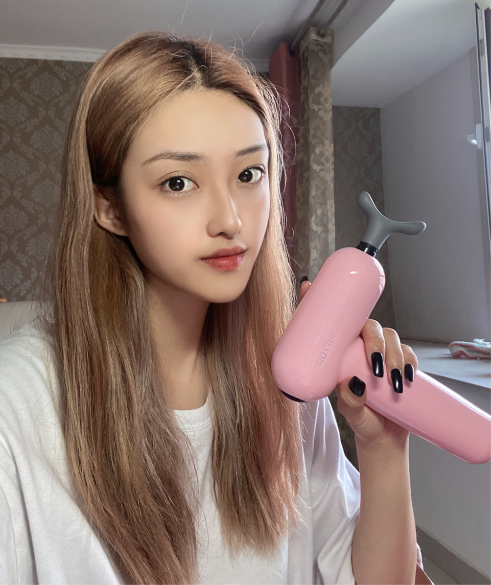
User experience feedback
I usually like to go to the gym, or go for a run. All in all, I exercise every day. But the problem also follows. After every workout, the muscles will be sore and even cramps. This is a muscle problem.
The Fittop super hit mini massage gun is a super good product I recently discovered. This product can really improve some of the problems that have been bothering me, resolve fascial nodules, improve adhesion, and prevent nodular fasciitis. Pain and tenderness. It is also very convenient to use, and the massage effect is also very good. In addition to eliminating muscle legs, friends who have been sedentary for a long time can also use this mini massage gun to eliminate thigh edema.
This is very friendly for us, no longer have back pain due to sitting for a long time.
AI touch adjustment, 5 levels of speed, 3 massage heads adapted to different parts And low noise, long battery life, it is very considerate, and it looks high-grade.
Friends, what are you waiting for, it's time to refine ourselves.

Slide 26
PART 2. Super Hit Mini
Application scenarios

Slide 27
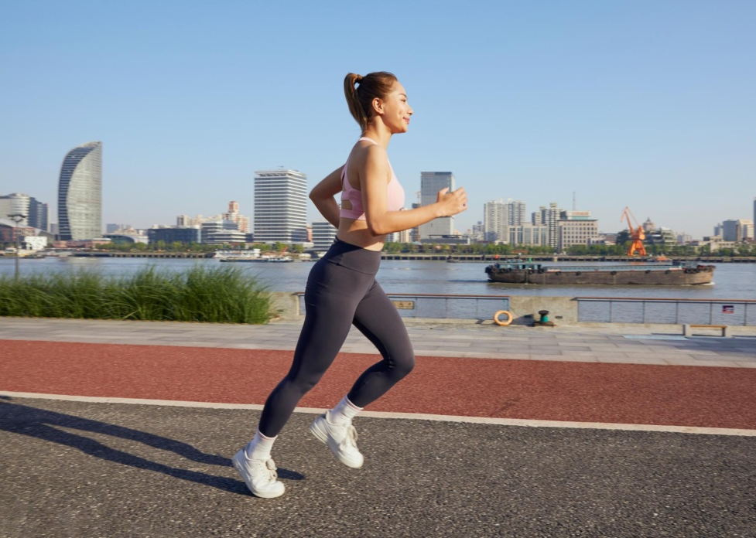
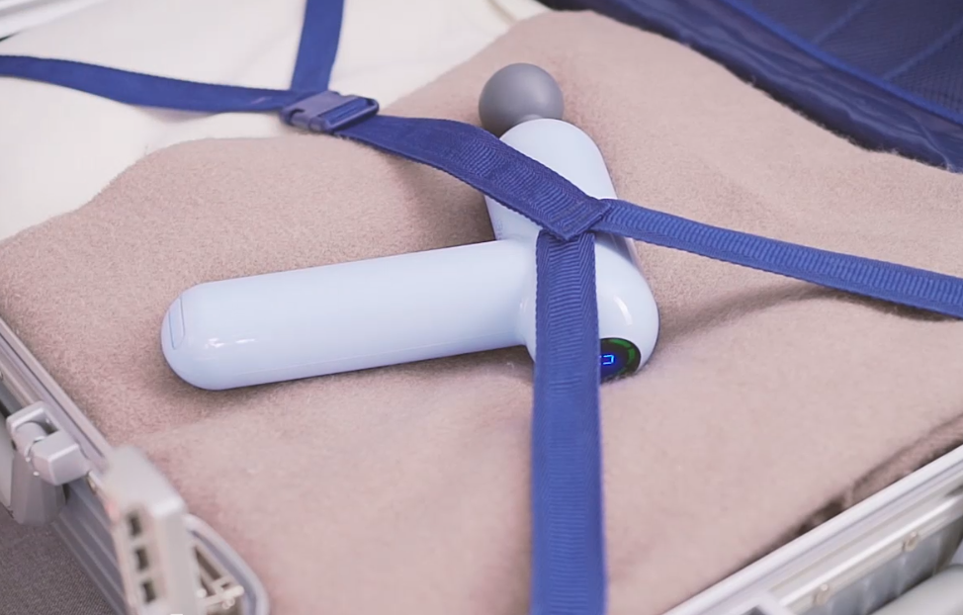
使用场景：运动场所（打球，跑步等）、逛街、旅行
Warm-up before fitness to protect muscles from straining and recovery after exercises to relieve muslce soreness
To help relieve muscles fatigue after long-time walking
Enjoying yourself a relaxing massage hours while in travelling

Slide 28
PART 3. Super Hit Mini
Product parameters

Slide 29
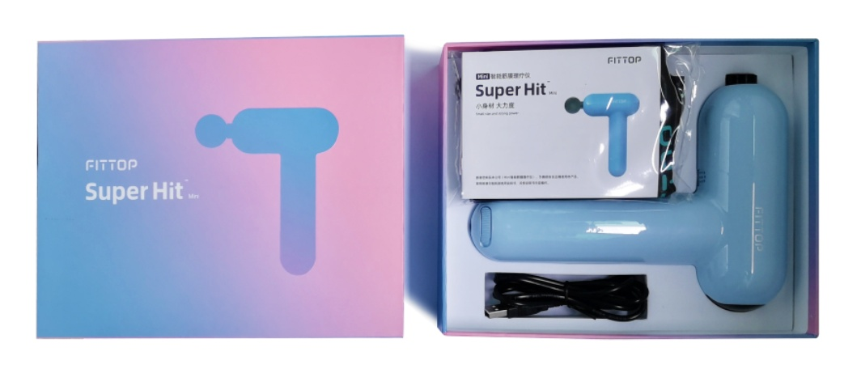
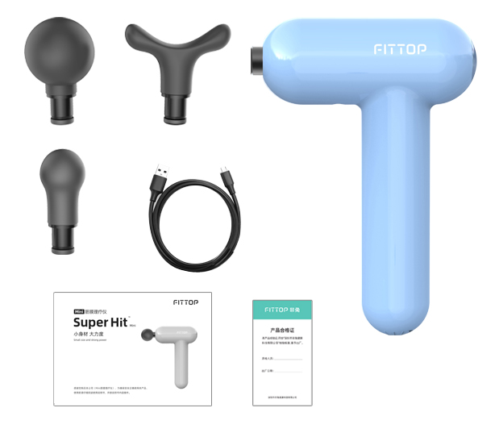
Parameters and Package
Product model number: FSM71
Product size: 200*154*55mm
Product weight: about 0.6kg
Rated voltage: 5V
Rated current: 2000mA
Rated power: 10W
Charging time: about 4.5 hours
Battery capacity: 2400mAh
Battery life: about 4 hours (high speed)
Massage head: 3 different massage heads
Gear selection: 5 gears, stepless speed regulation mode
Vibration frequency: maximum speed 3500RPM+-10%
Power supply mode: rechargeable lithium battery

Slide 30
PART 4. Super Hit Mini
Product pictures

Slide 31
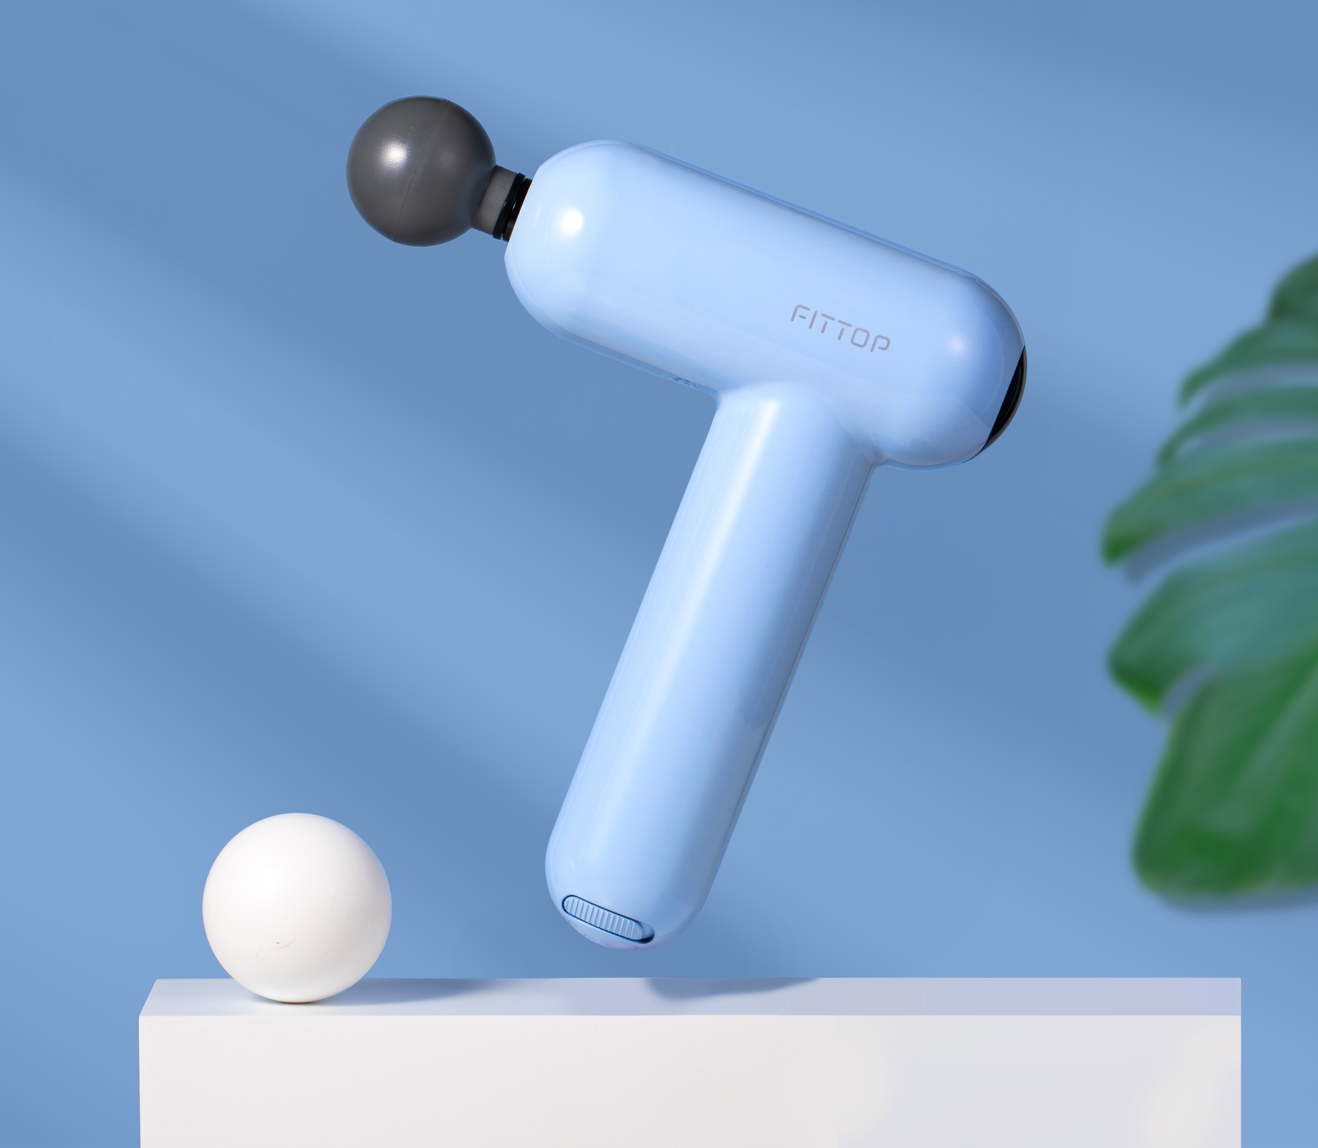
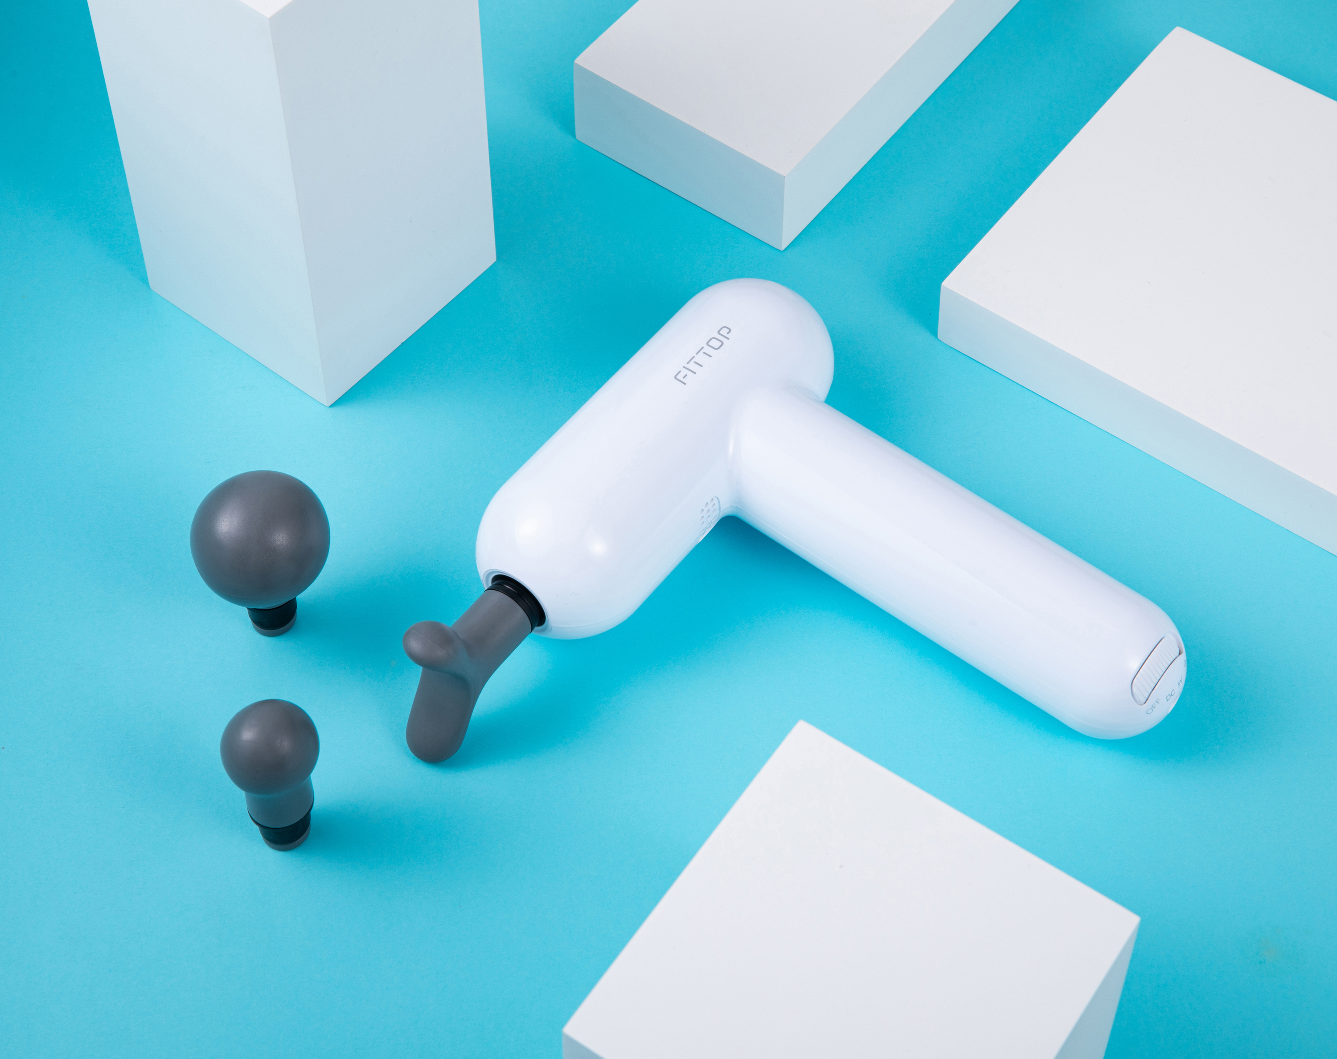
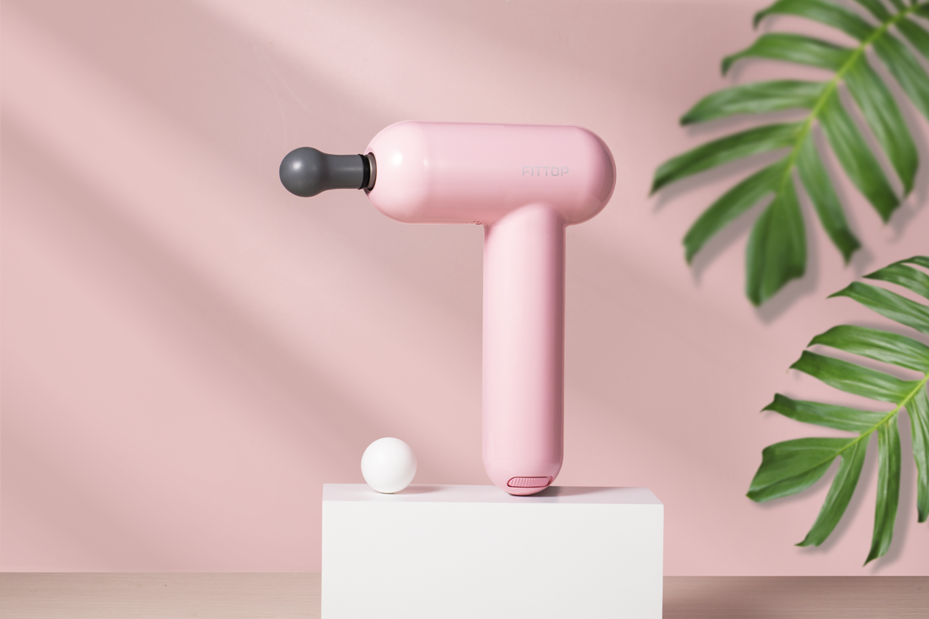

Slide 32
We aim to develop the most unique and competitive product to help your business growth!
THANK YOU

